Slide 1
ŠIBENIK-KNIN COUNTY

Slide 2
INTRODUCTION
Šibenik is a beautiful small town in the heart of Dalmatia
As beautiful as Šibenik is, so beautiful is its surroundings
If you decide to visit Šibenik, you should also look at te following locations

Slide 3
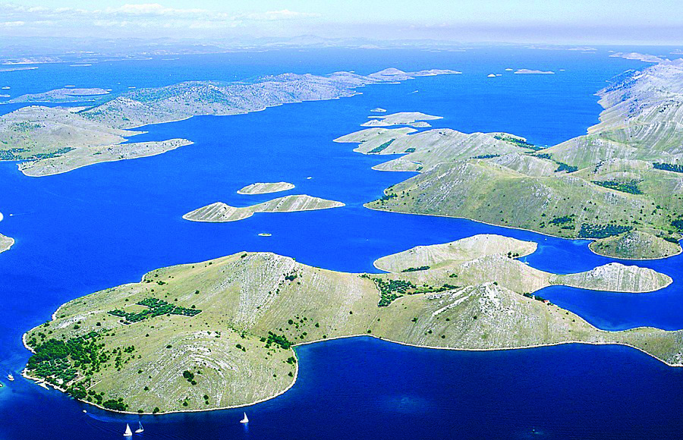
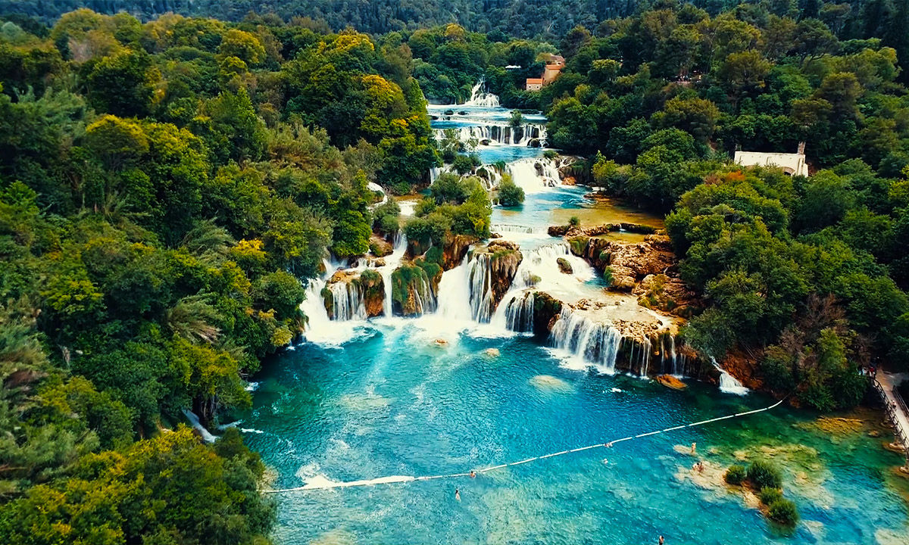
NATIONAL PARKS
National park Krka is located next to Skradin (a small town)
Krka is a beautiful river, which has many waterfalls and lakes
The most popular waterfall is Skradinski buk, and the most popular lake is Prokljansko jezero
Kornati archipelago of Croatia, also known as the Stomorski islands, is located in the northern part of Dalmatia
Kornati are the densest archipelago in the Mediterranean Sea

Slide 4
SKRADIN
Skradin is a small town in the Šibenik-Knin County of Croatia, with a population of 3,825
It is located near the Krka river
Fun Fact: Skradin is Bill Gates’ favorite summer resort

Slide 5
KNIN
Knin is a city located in the Dalmatian hinterland
It is also known as Zvonimir’s Town (it got it’s nickname by the name of Zvonimir)
Knin is a small famous town and the most famous attraction is the Knin Fortress

Slide 6
VODICE
The charming town of Vodice used to be a fishing village
It is located on the shores of Adriatic sea
Vodice is known for its numerous tourist offers and is a popular tourist destination

Slide 7
MURTER
Murter is an island in central Dalmatia, and is connected to Tisno by a bridge
It is known for its beautiful beaches and crystal clear sea
It is great location for hiking,biking,fishing, kayaking and paintball

Slide 8
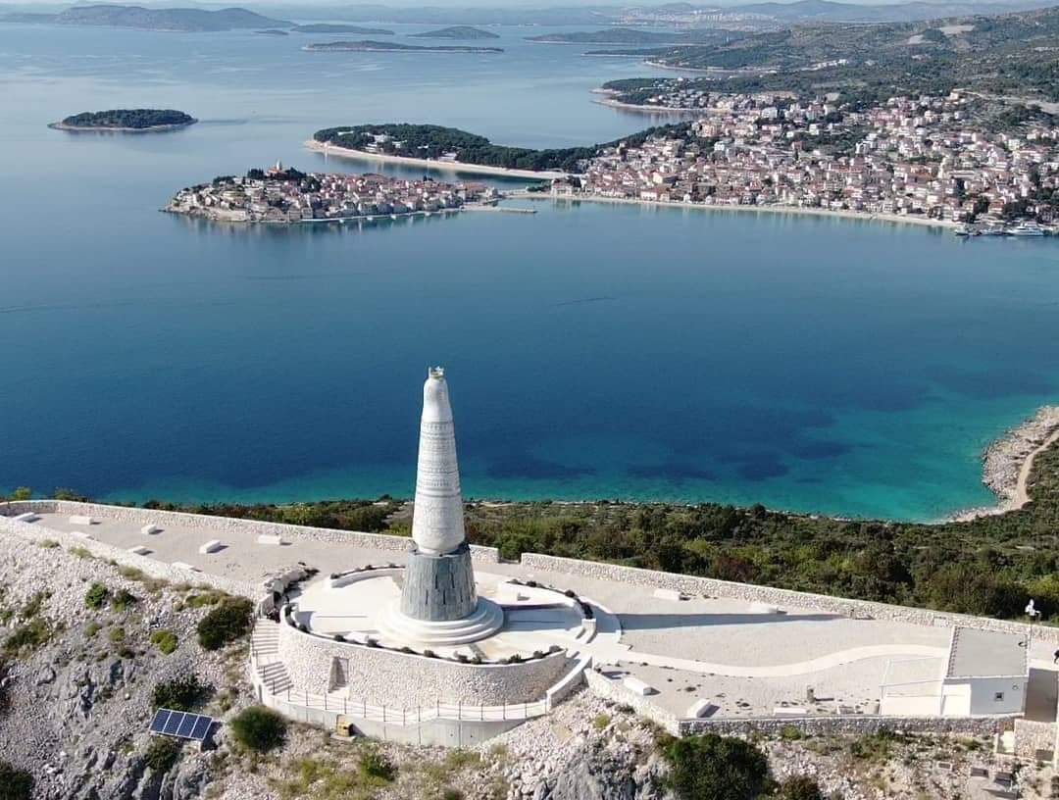
PRIMOŠTEN
Primošten is a wonderful place located on the Adriatic coast between the towns Šibenik and Trogir
It is a combination of Mediterranean landscape and narrow streets
Some of the sights: Church of st. Juraj, Church of st. Roko, Church of Our Lady of Mercy and Statue of Our Lady of Loreto
Along with the statue of Our Lady of Loreto, a lookout with a beautiful panaronic view: On the entire Šibenik archipelago and the open sea

Slide 9
SOLARIS
Solaris is located on a beatiful peninsula 6 kilometers from the center of Šibenik by the sea
It is surrounded by lush vegetation and a 4km long beach
Solaris(Amadria Park) is a resort with 5 hotels, aquapark, camp and many attractions and activities that include the Dalmatian ethno village

Slide 10
FALCONRY CENTER DUBRAVA
The Dubrava Falconry Center is the only such center in Croatia where different species of birds of prey can be seen
It is located in the dense pine forest of Šibenik’s Dubrava
A special program has been prepared for visitors during which they can enjoy the beauty of fslcon flight and be”face to face” with these amazing celestial hunters
The center has been breeding various types of predators for many years, and a special place is occupied by hospital wounded, sick or starving birds that need help

Slide 11
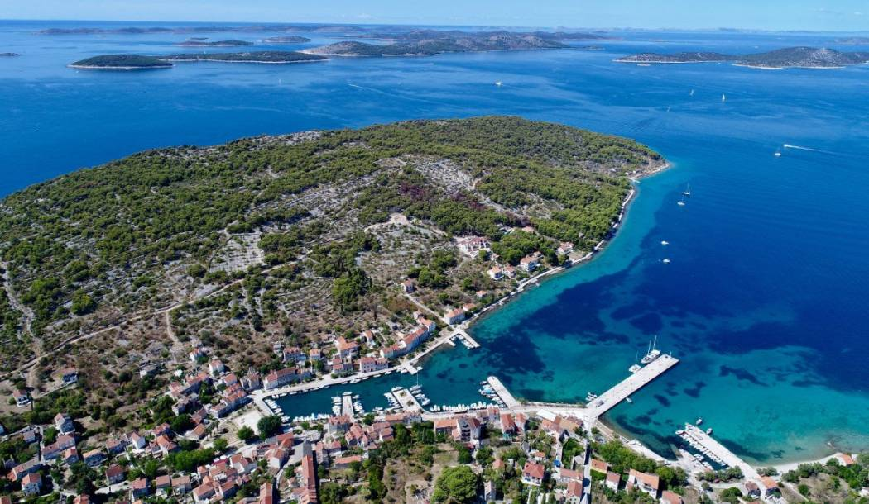
ISLANDS
Šibenik has a lot of beautiful islands: Zlarin,Prvić,Kaprije,Žirje,Krapanj…
The island of Krapanj is the lowest and smallest inhabited island in the Adriatic
Krapanj is an island with a century-old tradition of diving, sponge-making and fishing
Zlarin is ofen called the Golden Island or Green Island because of its untouched natural beauty
Residents popularize the island with a unique hobby, which is coral extraction and making coral jewelry
It is one of the sunniest islands in the Adriatic Sea and is known for its sandy and „wild” beaches

Slide 12
These were the most famous attractions, but Šibenik-Knin county gives even more attractions that definitely worth a look!

Slide 13
THANK YOU FOR WATCHING!
Made by: Roko Erceg, Niko Radovčić and Filip Knez 7.a

