Slide 1
A STORY FROM… GERMANY

Slide 2
BROTHERS GRIMM

Slide 3
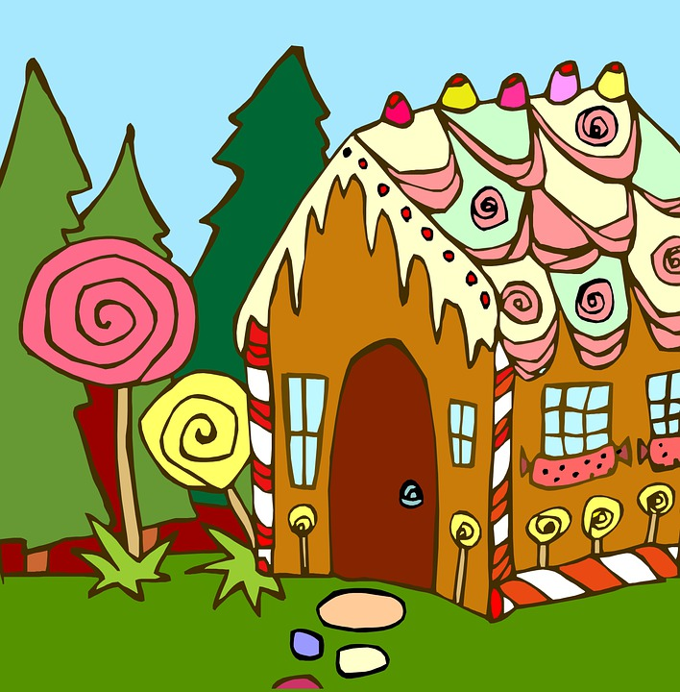
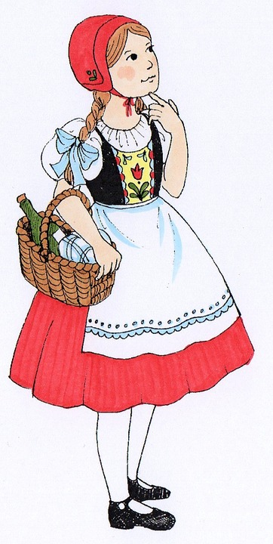
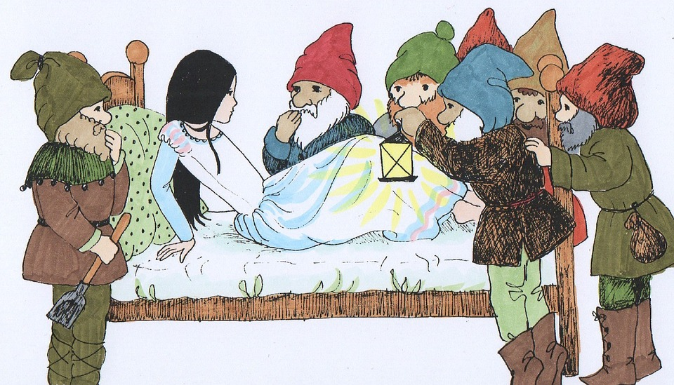
STORIES

Slide 4
THE QUEEN BEE
A BEE
MOTHER

Slide 5
HONEY

Slide 6
BUMBLEBEE
A LOT OF BUZZZZZZZZZ
BUT
NO HONEY
ILI…
PUNO ZUJI, MALO MEDA DAJE.

